Slide 1
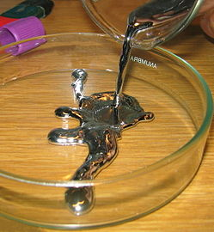
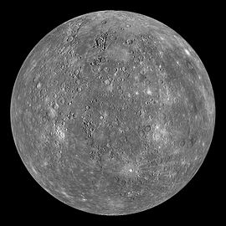
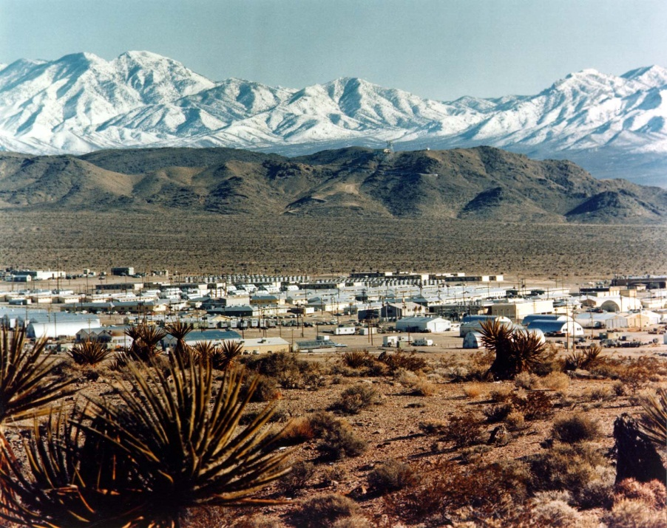
Their articles need disambiguation
What have these pictures got in common?
MERCURY

Slide 2
Definition
Disambiguation in Wikipedia is the process of resolving the conflicts that arise when a single term is ambiguous—when it refers to more than one topic covered by Wikipedia articles.
Can you think of any topics that may need disambiguating?
Notes:
Plain English definition: What we do when words have more than one meaning in Wikipedia. E.g. names, places, nouns, initials, you name it.

Slide 3
Article name
May need a disambiguating term
E.g. Mercury (planet)
Or Mercury, Nevada
Is there a primary topic?
A meaning that is much more likely to be used
It would not have a disambiguator: Mercury
But in this case, there is no primary topic
So Mercury is a disambiguation page

Slide 4
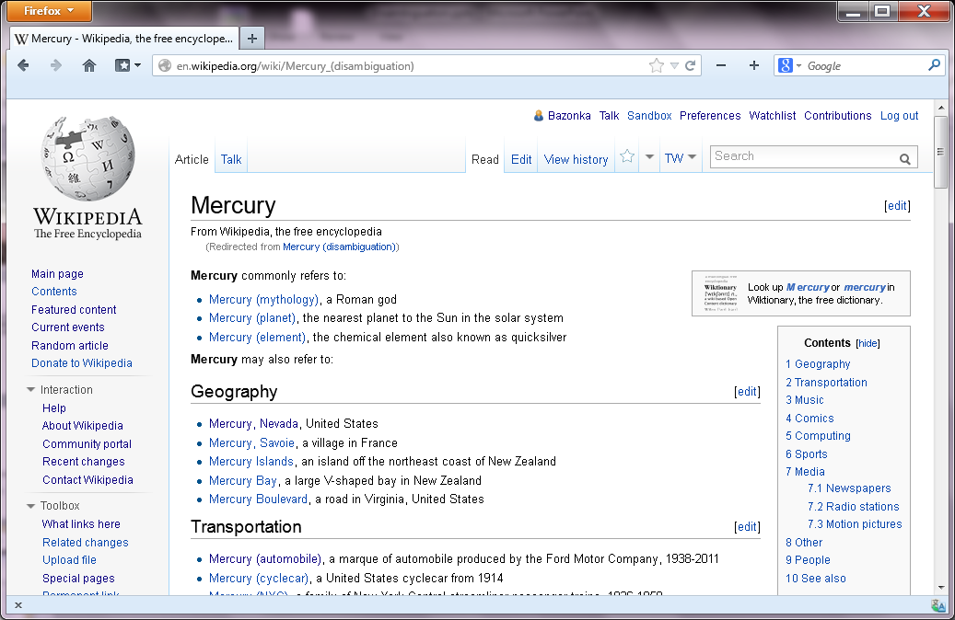
Disambiguation (dab) page

Slide 5
Primary topic
If there is a primary topic, it goes at the base name, e.g. London
Other articles are listed in a disambiguation page, e.g. London (disambiguation)
The primary page will have a hatnote linking to the disambiguation page
For other uses, see London (disambiguation).

Slide 6
Exercise
How would you disambiguate the articles on the handout?
All linked through disambiguation page?
One primary topic, others under dab page?
One primary topic, one other through hatnote?
None needed?
Something else?

